Slide 1
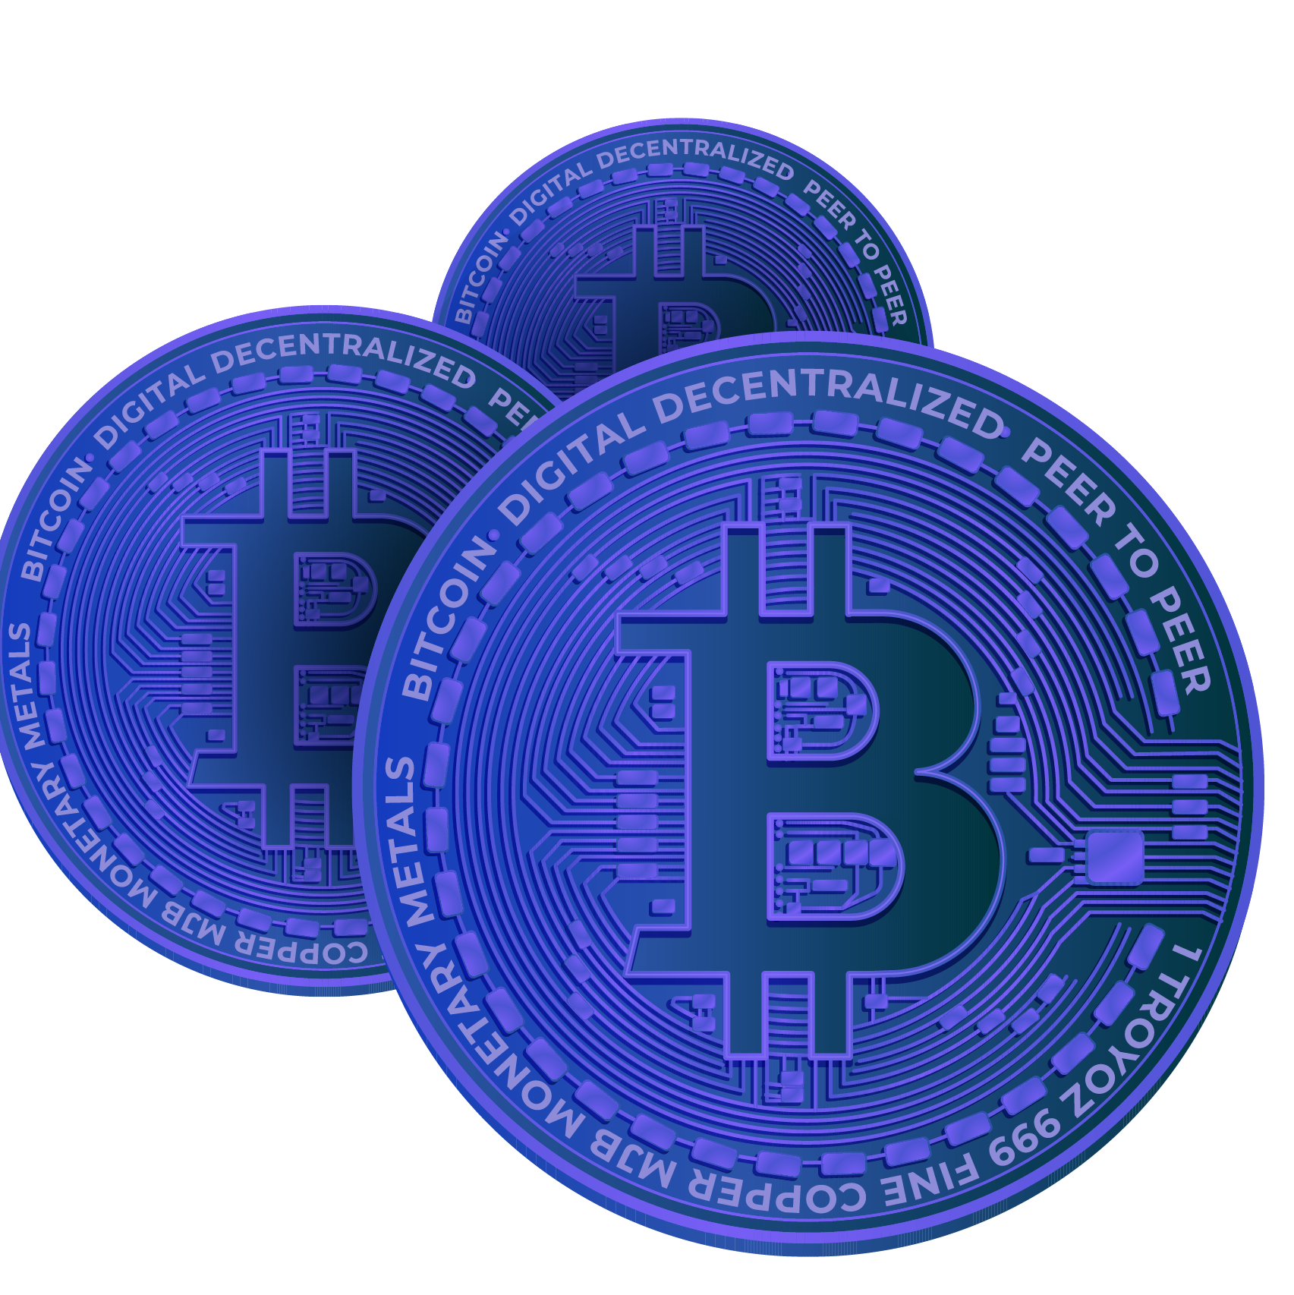
Bitcoin Dataset
SQL Project On Bitcoin Dataset
BY-PRASHANT UPADHYAY
Notes:
1. Table of contents
2. Introduction
3. Our company
4. Our team
5. Problem
6. Them vs. us
7. Solution
8. SWOT analysis
9. Product overview
10. Our plans
11. Product demo
12. Traction
13. Case study
14. Reviews
15. Awards
16. Market size
17. Target
18. Competitors
19. Business model
20. Timing
21. Predicted growth
22. Investment

Slide 2
Acknowledgements
I would like to express my sincere gratitude to my mentor, Mr. Vikas Aatrey, for their invaluable guidance, encouragement, and support throughout this project.

Slide 3

Introduction
Bitcoin is a decentralized digital currency created in 2009 by Satoshi Nakamoto. It operates on blockchain technology, enabling secure peer-to-peer transactions without intermediaries. Limited to 21 million coins, Bitcoin is often seen as digital gold and has sparked the rise of cryptocurrencies and decentralized finance worldwide.

Slide 4
Contents of this dataset
Here’s what you’ll find in this Slidesgo template:
Total Circulating Supply: What was the total number of bitcoins in circulation on the latest recorded date?
Transaction Count:What is the total number of transactions (btc_n_transactions_total) recorded in the dataset?
Peak Transactions: On which date was the highest number of transactions (btc_n_transactions) recorded?
Market Price Analysis: What was the highest recorded btc_market_price during the given period?
Estimated Transaction Volume: Which date had the highest btc_estimated_transaction_volume in USD?
Miner Revenue Analysis: What was the total revenue earned by miners (btc_miners_revenue) over all recorded days?
Transaction Fees Analysis: On which date were the highest btc_transaction_fees recorded?
Block Size Trends: What was the average btc_avg_block_size over the given period?
Unique Addresses Trend: Which date had the highest number of btc_n_unique_addresses?
Transaction Cost Analysis: What was the highest btc_cost_per_transaction recorded?
Blocks Size Analysis: How many times did btc_blocks_size exceed 0 in the dataset?
Transaction Efficiency: What is the average number of transactions per block (btc_n_transactions_per_block)?
Trade Volume Trends: What was the total btc_trade_volume for all available records?
Hash Rate Analysis: What was the highest btc_hash_rate recorded in the dataset?
Mining Difficulty Trends: What was the average btc_difficulty over the given period?
Transaction Cost Percentage: On which date was the highest btc_cost_per_transaction_percent recorded?
Orphaned Blocks Count: How many orphaned blocks (btc_n_orphaned_blocks) were recorded in total?
Daily Output Volume: Which date had the highest btc_output_volume recorded?
Transaction Exclusions: What was the total number of transactions excluding popular ones (btc_n_transactions_excluding_popular)?
Supply Growth: What is the percentage increase in btc_total_bitcoins from the first recorded date to the last?

Slide 5
“Bitcoin is a good thing. It will probably be the single best technology for getting us to a decentralized future.”
—Elon Musk (CEO of Tesla & SpaceX)

Slide 6
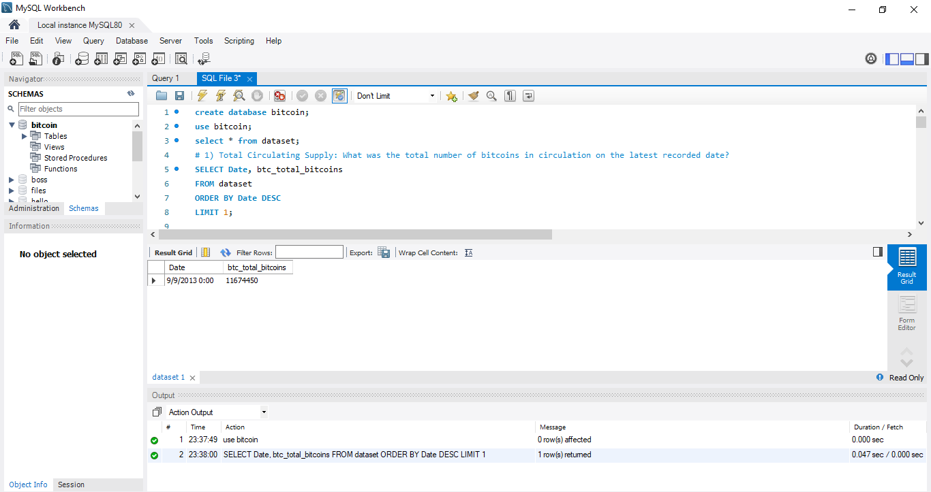
Q1. Total Circulating Supply: What was the total number of bitcoins in circulation on the latest recorded date?

Slide 7
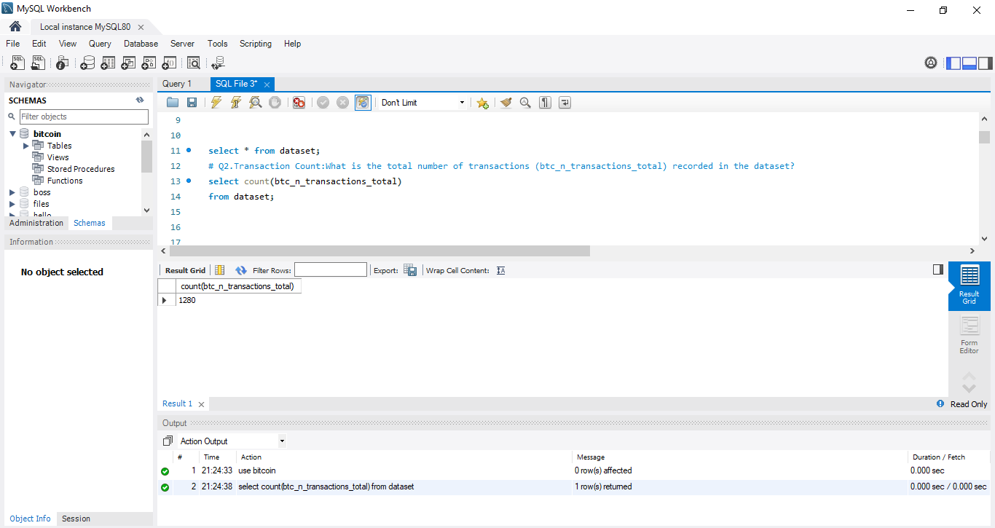
Q2.Transaction Count:What is the total number of transactions (btc_n_transactions_total) recorded in the dataset?select count(btc_n_transactions_total).
You can enter a subtitle here if you need it

Slide 8
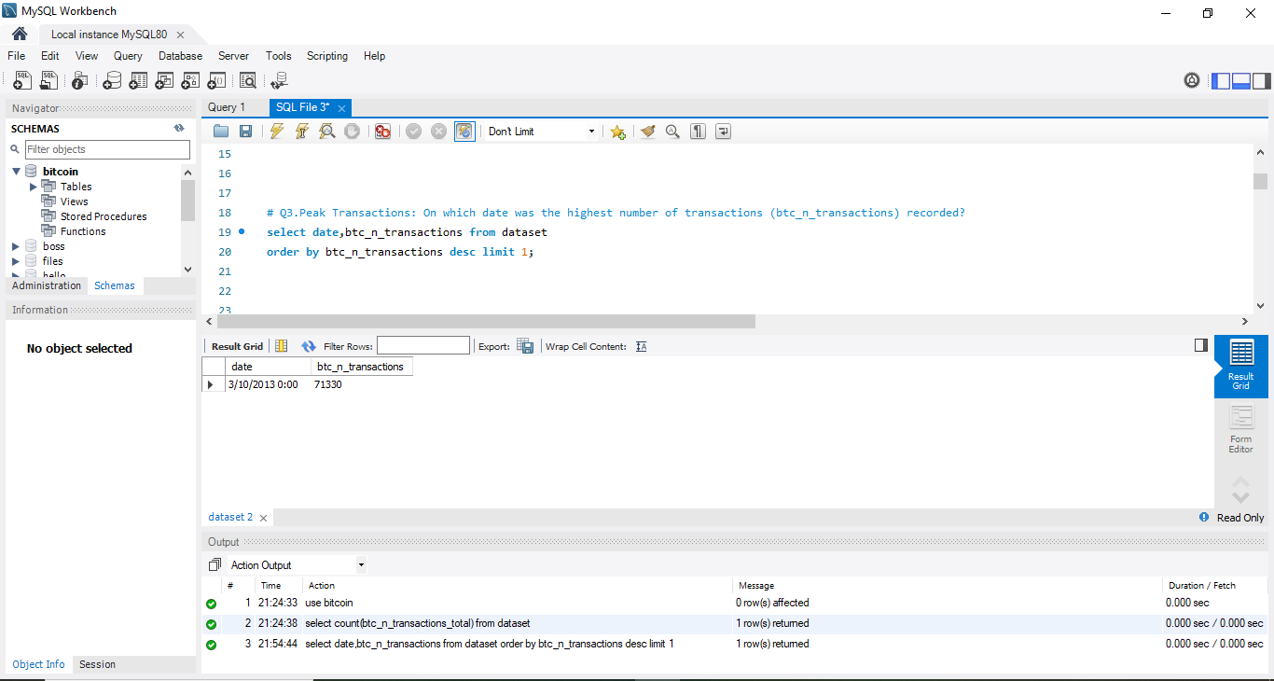
Q3. Peak Transactions: On which date was the highest number of transactions (btc_n_transactions) recorded?
Mercury
Venus
Mars
Mercury is the closest planet to the Sun
Venus has a beautiful name, but it’s hot
Despite being red, Mars is actually a cold place

Slide 9
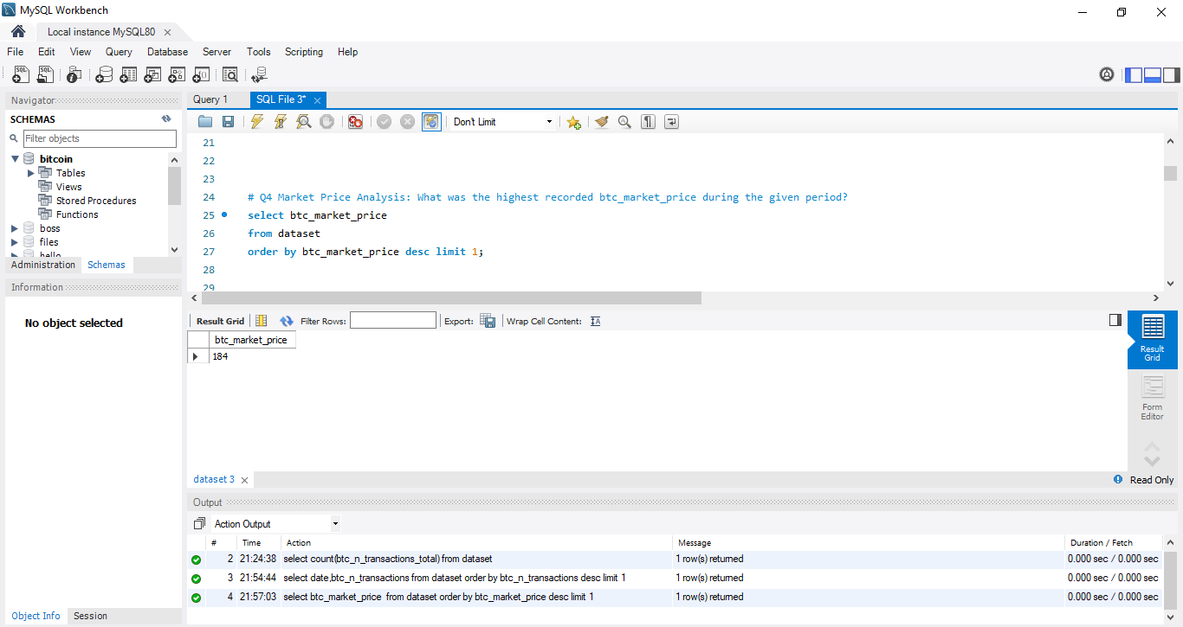
Q4. Market Price Analysis: What was the highest recorded btc_market_price during the given period?
James Doe
Alex Jones
Here you can describe your team member
Here you can describe your team member
John Smith
Nick Williams
Here you can describe your team member
Here you can describe your team member

Slide 10
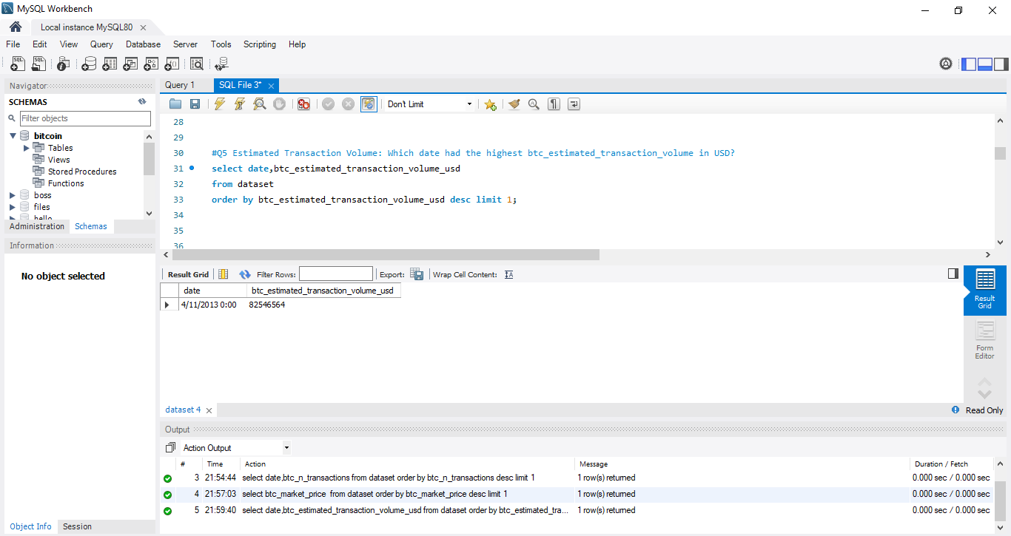
Q5. Estimated Transaction Volume: Which date had the highest btc_estimated_transaction_volume in USD?
S
W
O
T
Strengths
Weaknesses
Opportunities
Threats
Mercury is the closest planet to the Sun
Despite being red, Mars is actually a cold place
Venus has a beautiful name, but it’s hot
Neptune is the farthest planet from the Sun

Slide 11
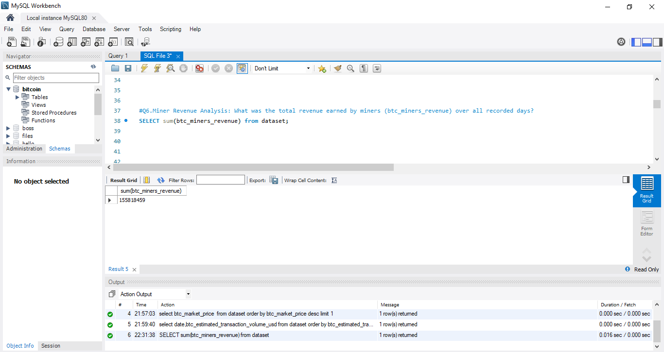
Q6. Miner Revenue Analysis: What was the total revenue earned by miners (btc_miners_revenue) over all recorded days? SELECT sum(btc_miners_revenue) from dataset;
Mercury
Venus
Mars
Mercury is the closest planet to the Sun
Venus has a beautiful name, but it’s hot
Despite being red, Mars is actually a cold place
Jupiter
Neptune
Earth
Jupiter is the biggest planet of them all
Neptune is the farthest planet from the Sun
Earth is the beautiful planet we all live on

Slide 12
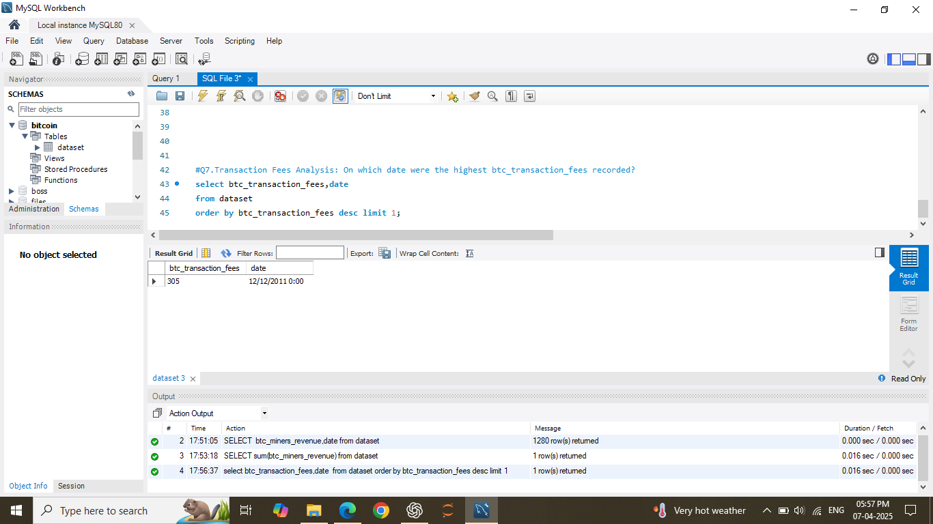
Q7. Transaction Fees Analysis: On which date were the highest btc_transaction_fees recorded?
Venus
Neptune
2020
Venus has a beautiful name, but it’s hot
2022
Neptune is the farthest planet from the Sun
Mercury
Mars
Mercury is the closest planet to the Sun
2021
Despite being red, Mars is actually a cold place
2023

Slide 13
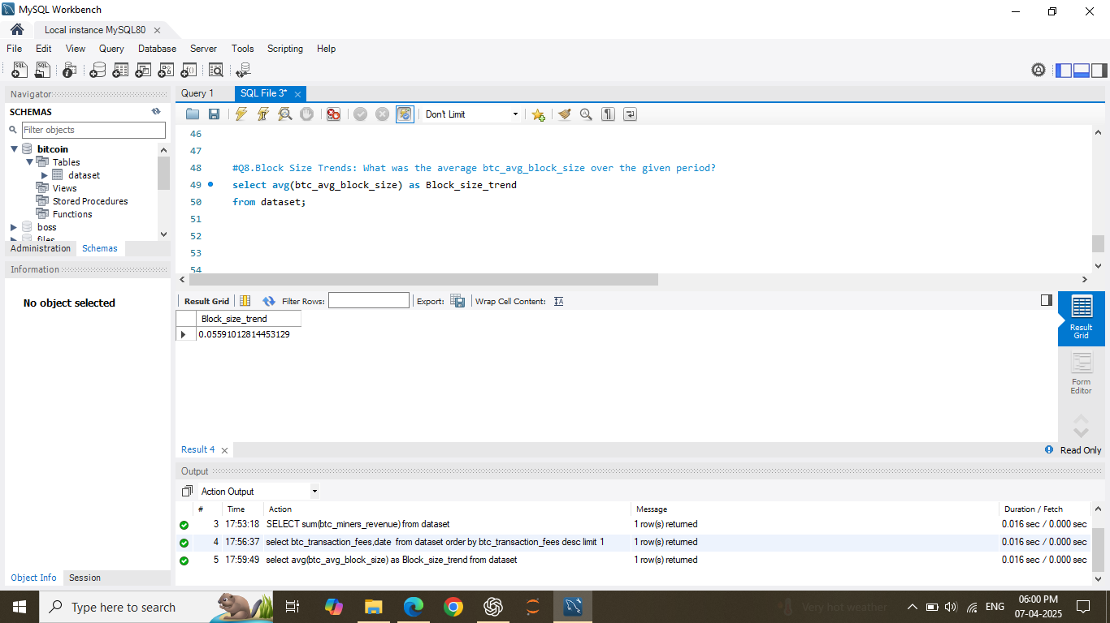
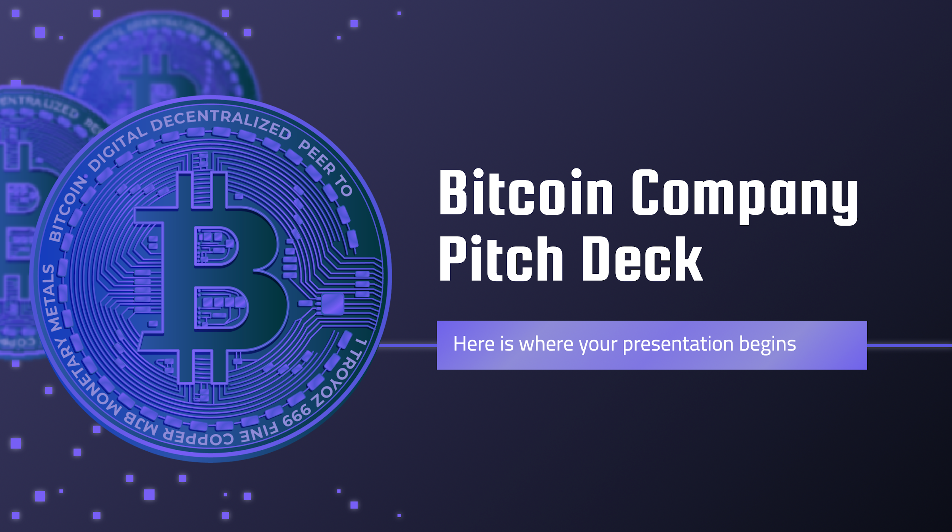
Q8. Block Size Trends: What was the average btc_avg_block_size over the given period?
You can replace the image on the screen with your own work. Right-click on it and then choose “Replace image” so you can add yours

Slide 14
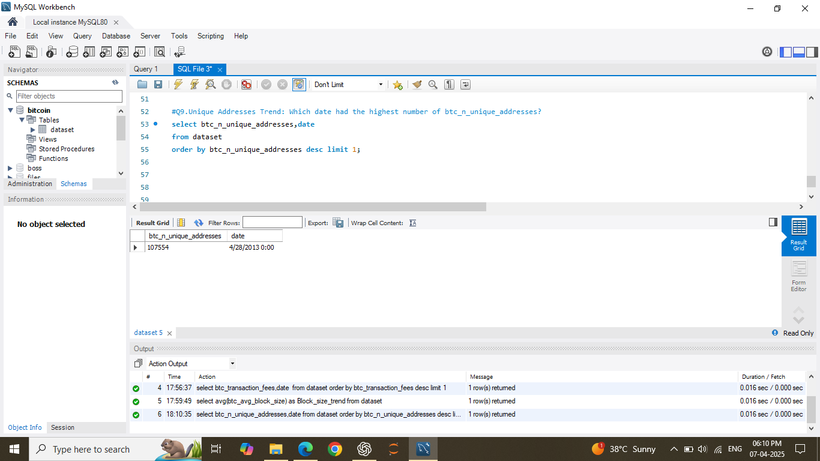
Q9. Unique Addresses Trend: Which date had the highest number of btc_n_unique_addresses?
15K
30M
75%
Mercury
Venus
Mars
Mercury is the closest planet to the Sun
Venus has a beautiful name, but it’s hot
Despite being red, Mars is actually cold

Slide 15
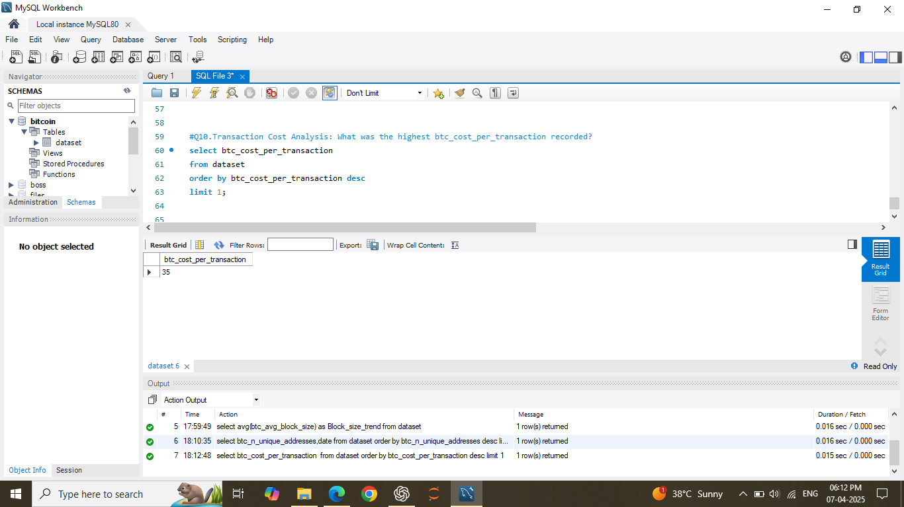
Q.10 Transaction Cost Analysis: What was the highest btc_cost_per_transaction recorded?
 | Challenge | Results | Solution
Project 1 | Mercury: the closest planet to the Sun | Venus: it has a beautiful name | Mars: it is actually a cold place
Project 2 | Jupiter: the biggest of them all | Earth: it is the planet we all live on | Neptune: farthest planet from the Sun
Project 3 | Saturn: it is a gas giant and has rings | Moon: the Earth has only one | Pluto: is now a dwarf planet

Slide 16
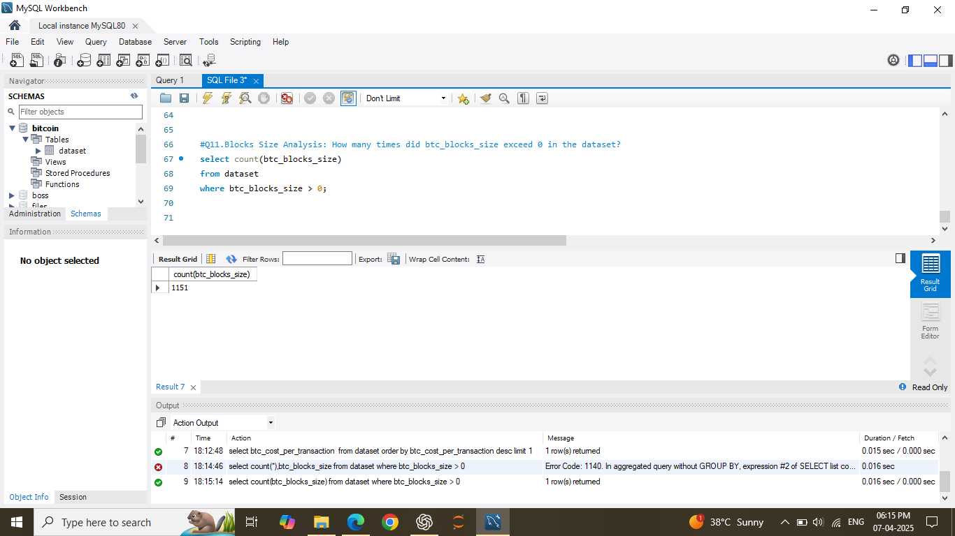
Q11. Blocks Size Analysis: How many times did btc_blocks_size exceed 0 in the dataset?
“Mercury is the closest planet to the Sun. It is a really hot place”
“Despite being red, Mars is actually a really cold place”
“Neptune is the farthest planet from the Sun”
—Jane Nicholson
—Nick Bender
—Jordan Bowman

Slide 17
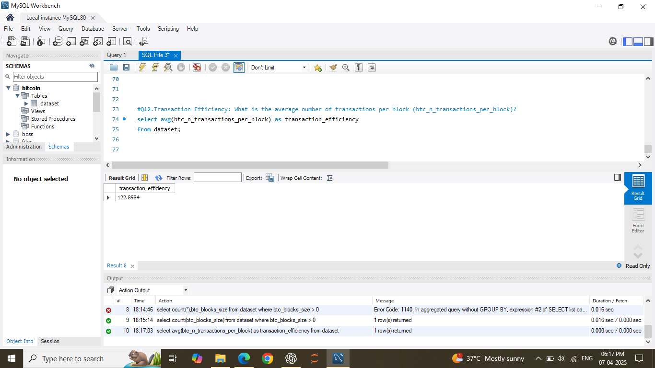
Q12. Transaction Efficiency: What is the average number of transactions per block (btc_n_transactions_per_block)?
Big numbers may help you catch your audience’s attention

Slide 18
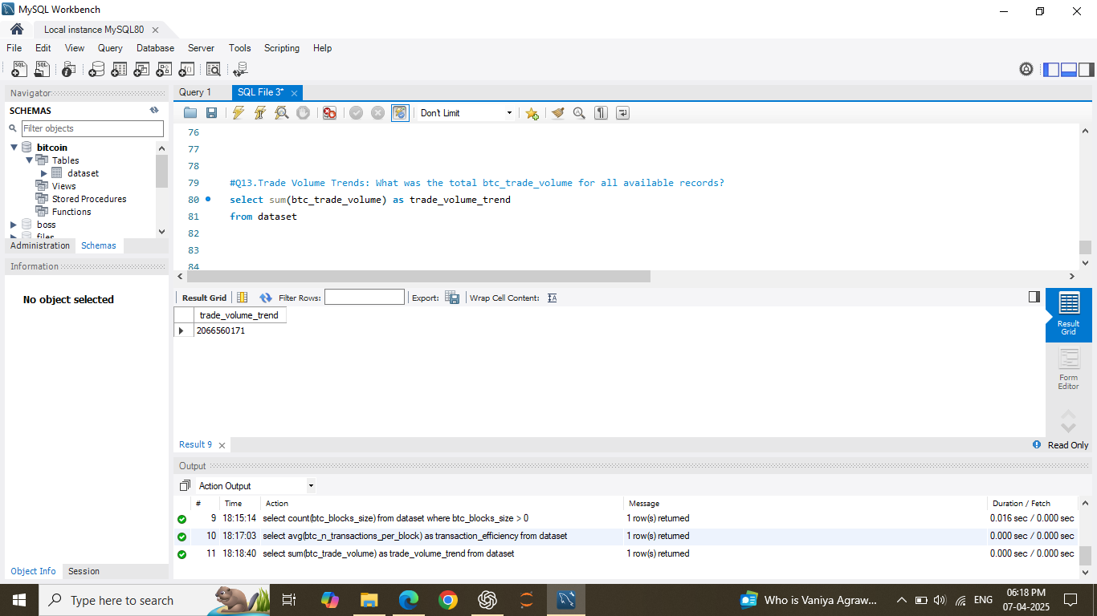
Q13. Trade Volume Trends: What was the total btc_trade_volume for all available records?

Slide 19

Q14. Hash Rate Analysis: What was the highest btc_hash_rate recorded in the dataset?
1st
2nd
Mercury
Venus
Mercury is the closest planet to the Sun
Venus has a beautiful name, but it’s hot

Slide 20
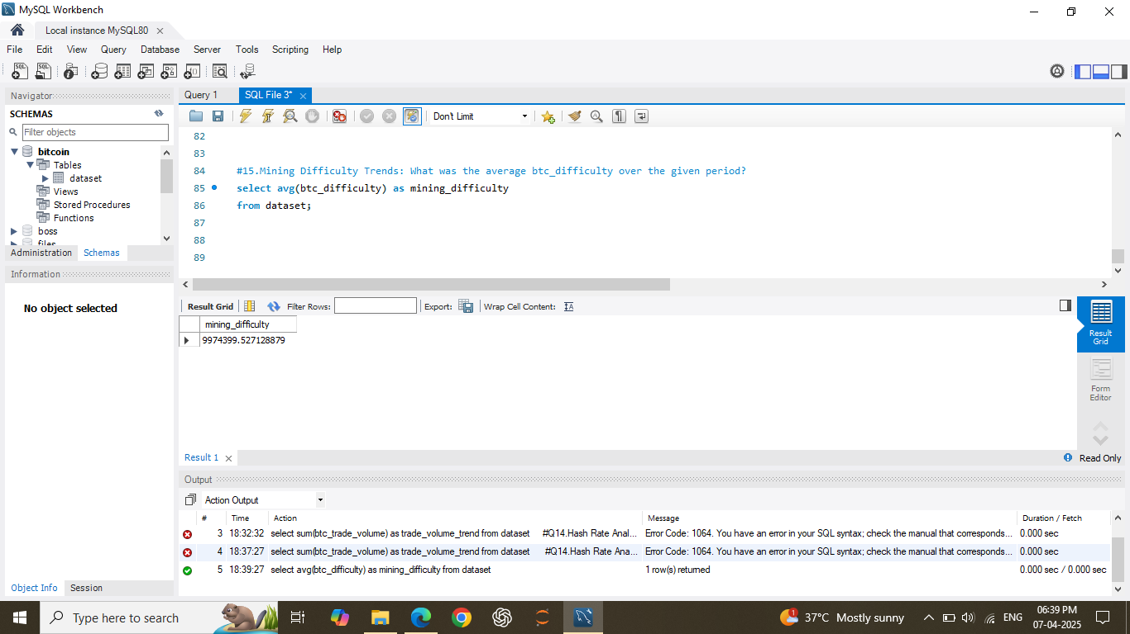

Q15. Mining Difficulty Trends: What was the average btc_difficulty over the given period?
30%
25%
Venus has a beautiful name, but it’s hot
Neptune is the farthest planet from the Sun
15%
30%
Mercury is the closest planet to the Sun
Despite being red, Mars is actually a cold place
To modify this graph, follow the link, change the data and paste the new graph here

Slide 21
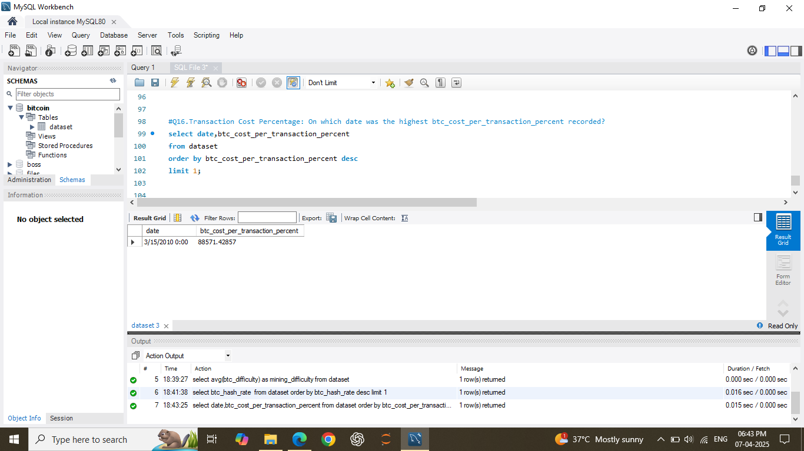
Q16. Transaction Cost Percentage: On which date was the highest btc_cost_per_transaction_percent recorded?
Men
60%
Average Spend
Women
40%
$100,000

Slide 22
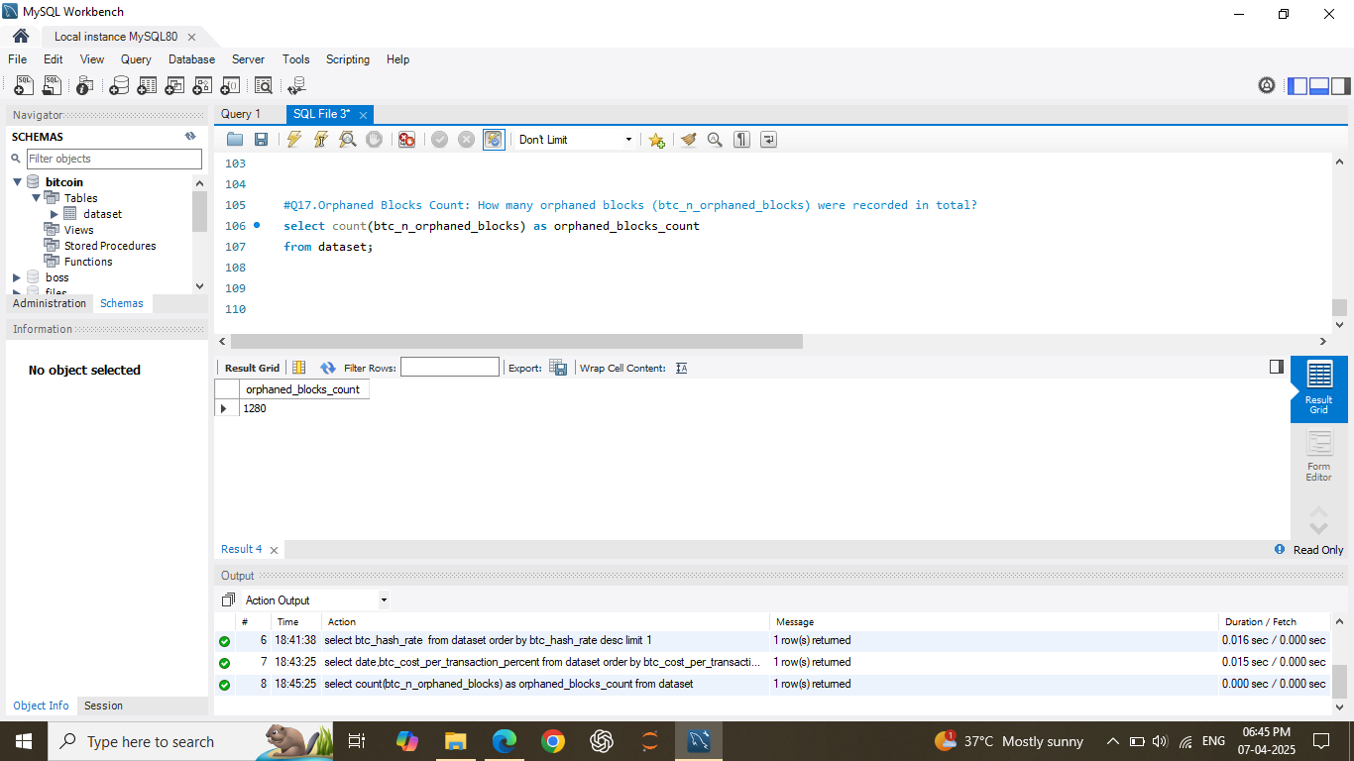
Q17. Orphaned Blocks Count: How many orphaned blocks (btc_n_orphaned_blocks) were recorded in total?
Venus
Venus has a beautiful name
Mercury
It is the closest planet to the Sun
Mars
Despite being red, Mars is cold

Slide 23
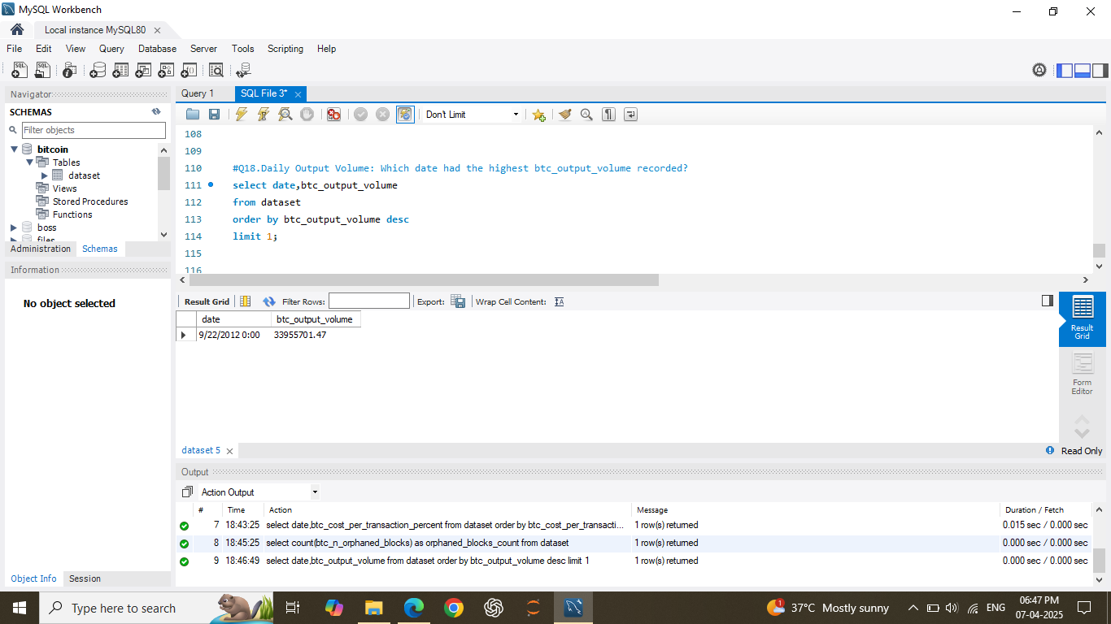
Q18. Daily Output Volume: Which date had the highest btc_output_volume recorded?
Venus
Neptune
Venus has a beautiful name, but it’s hot
Neptune is the farthest planet from the Sun
Mercury
Mars
Mercury is the closest planet to the Sun
Despite being red, Mars is actually a cold place

Slide 24
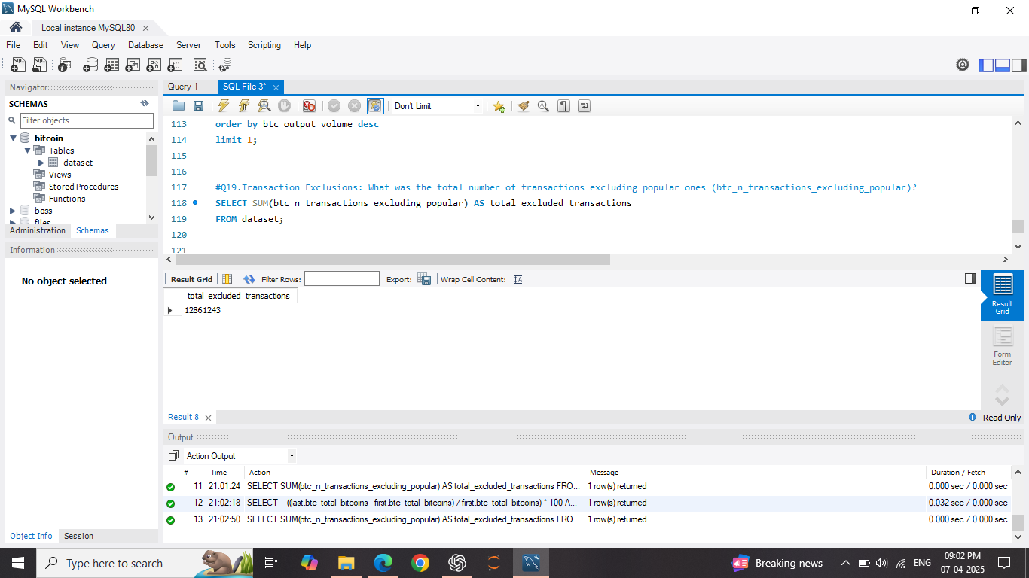
Q19. Transaction Exclusions: What was the total number of transactions excluding popular ones (btc_n_transactions_excluding_popular)?
01
03
Mercury is the closest planet to the Sun
Despite being red, Mars is actually a cold place
02
04
Venus has a beautiful name, but it’s hot
Neptune is the farthest planet from the Sun

Slide 25
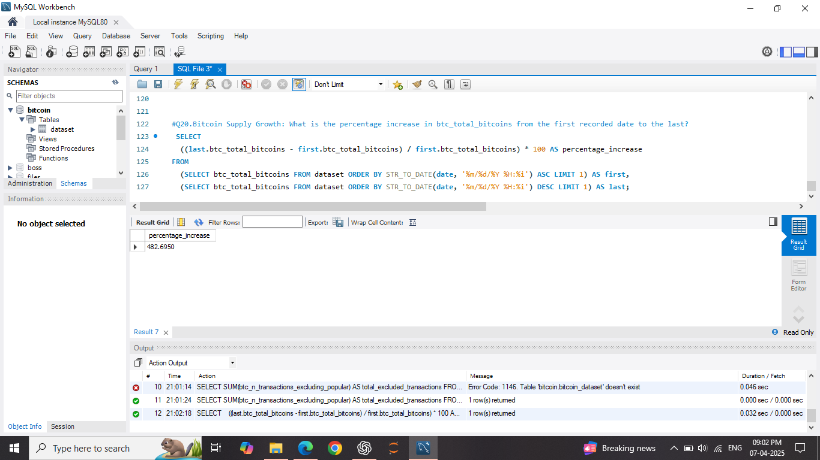
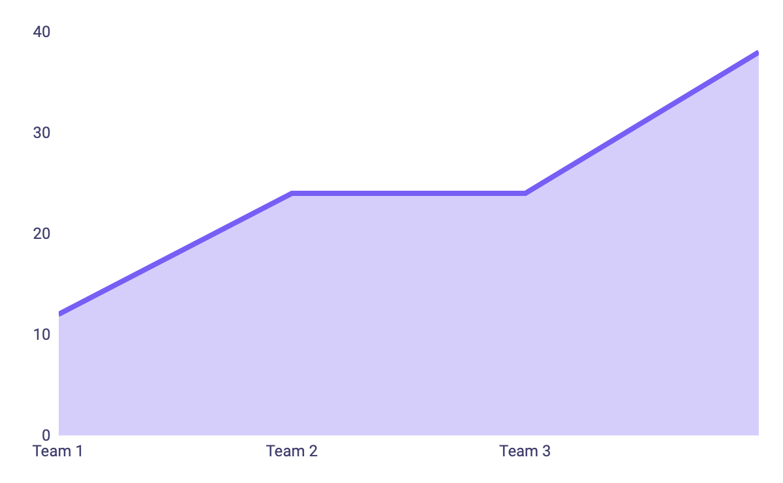
Q20. Bitcoin Supply Growth: What is the percentage increase in btc_total_bitcoins from the first recorded date to the last?
2021-2022
100
Venus has a beautiful name, but it’s terribly hot
50
2023-2024
25
It is the closest planet to the Sun. It is really hot
00
2021
2022
2023
2024
To modify this graph, follow the link, change the data and paste the new graph here

Slide 26

Thank you

